Slide 1
https://codeburst.io/algorithms-i-searching-and-sorting-algorithms-56497dbaef20

Slide 2
CSS143 Computer Programming (II)

Slide 3
Notes
Homework 1 grades will be out as early as this weekend
Homework 2 will be assigned by Thursday midnight (tonight)
No lecture next Monday (Martin Luther King Day)
Guest or remote lecture next Wednesday

Slide 4
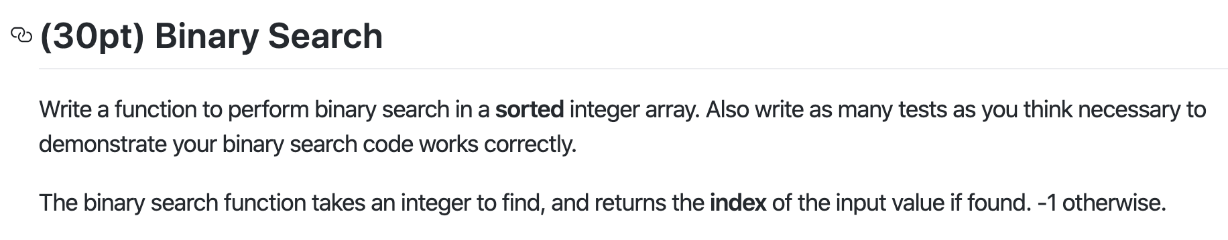
Homework 1 Review
Target: 14
1
3
5
7
9
10
12
12
14
14
18

Slide 5
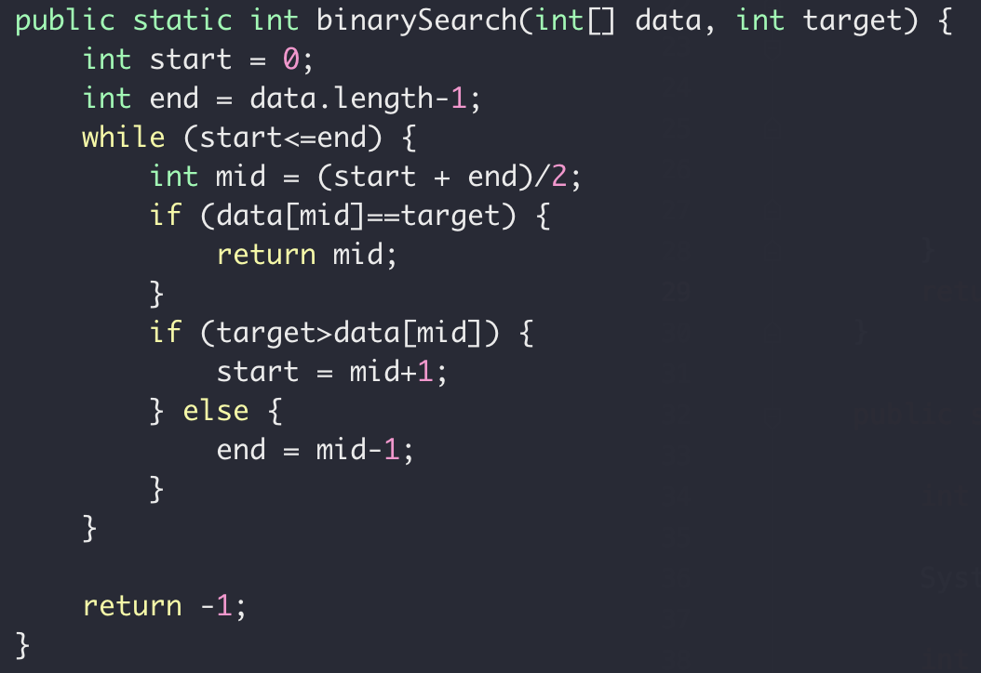
Homework 1 Review

Slide 6
Homework 1 Review

Slide 7
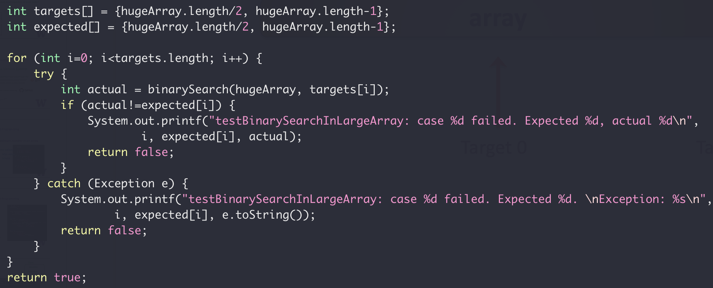
Homework 1 Review
Size: Integer.MAX_VALUE
Size: very large
array
Target 0
Target 1

Slide 8
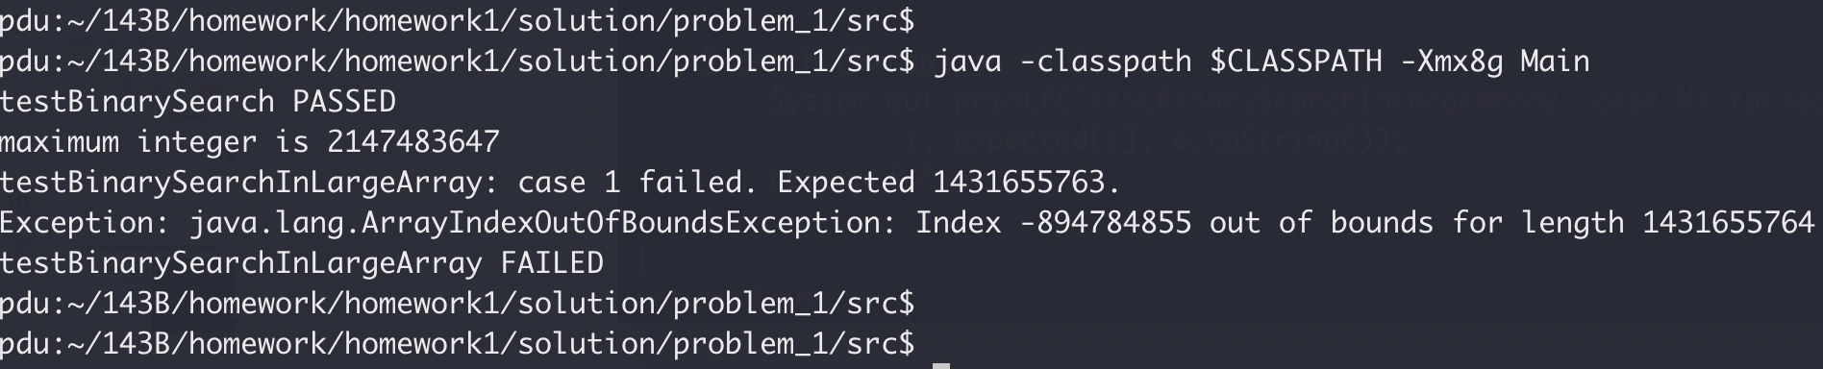
Homework 1 Review
Size: Integer.MAX_VALUE
Size: very large
array
Target 0
Target 1

Slide 9
Homework 1 Review

Slide 10
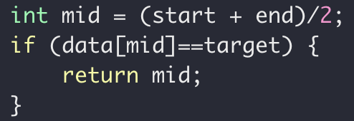
Homework 1 Review
Size: Integer.MAX_VALUE
array
start
mid
mid
end
start

Slide 11
Homework 1 Review
overflow
(start+end)>Integer.MAX_VALUE
Size: Integer.MAX_VALUE
array
start
end

Slide 12
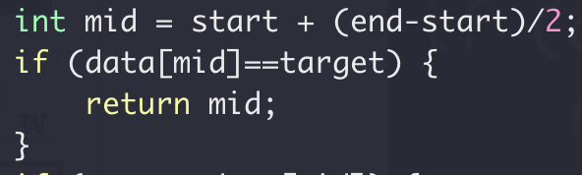

Homework 1 Review
Full code here

Slide 13
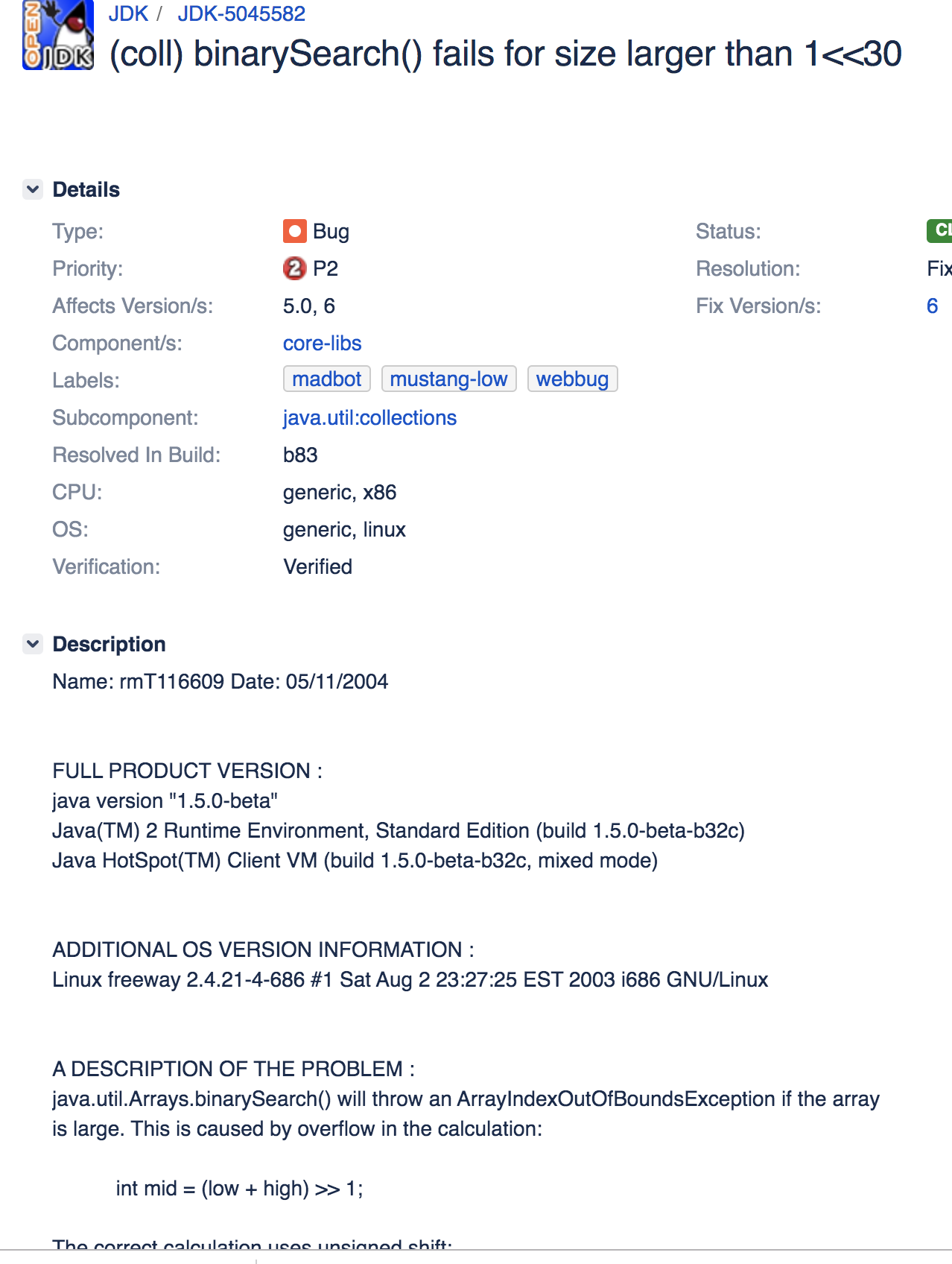
Homework 1 Review
https://bugs.openjdk.java.net/browse/JDK-5045582

Slide 14
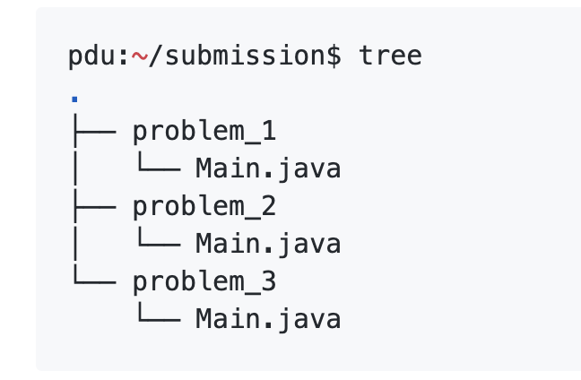
Homework Notes
Do not submit any other files other than being requested.
Do not submit binaries (.class files) !

Slide 15
Source Control in Slides
How are you keeping each updates of your code?

Slide 16
Source Control in Slides
Source Version Control
Keep a snapshots of your codes through time
Keep a snapshots of your codes through time
Each snapshot/version is called a “commit”
Each snapshot/version is called a “commit”
Compare with, restore to other commits
Compare with, restore to other commits
Keep saved commits remotely
Keep saved commits remotely
Full code here version x

Slide 17
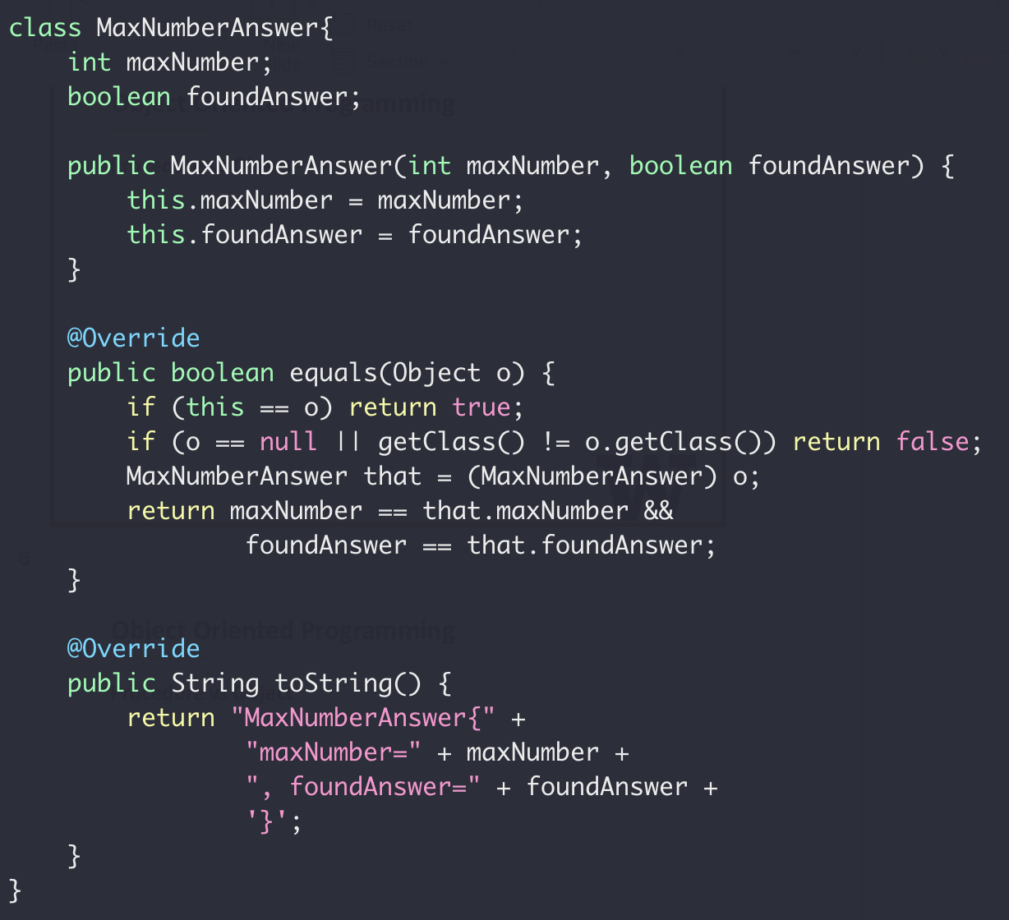
Object Oriented Programming
Find the maximum number in an array
Return value:
Max value
IsValid

Slide 18
Object Oriented Programming
Class
Variables
Variables
Methods
Methods
A class is a type like
int, float, boolean

Slide 19
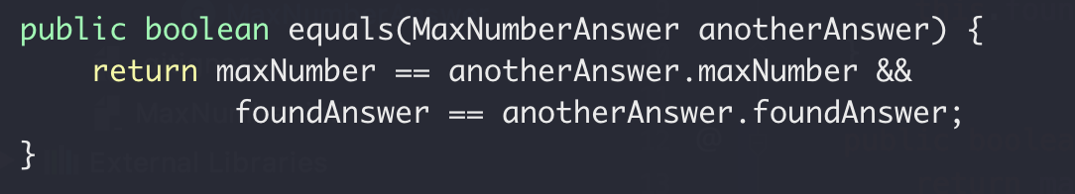
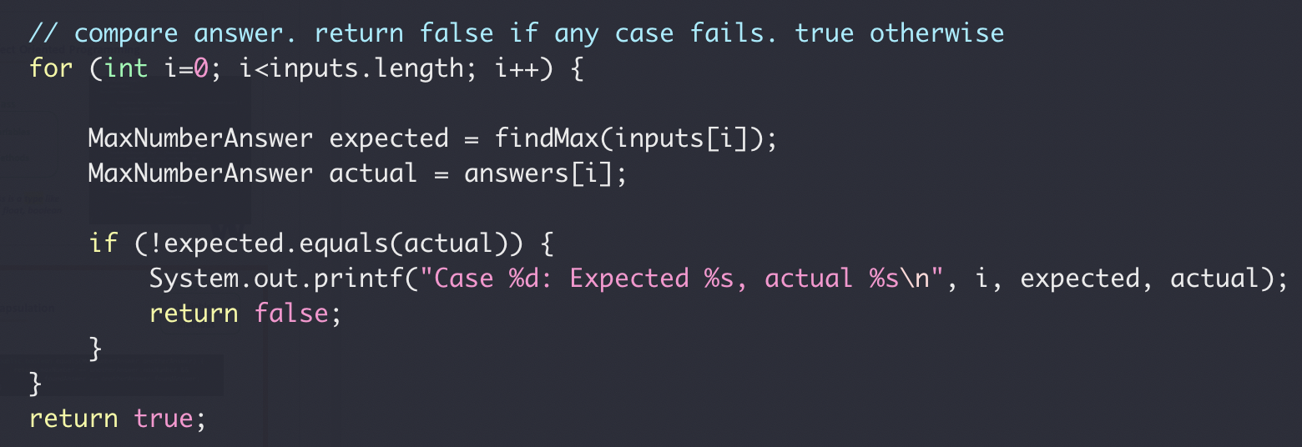
Encapsulation
Class
Variables
Methods
MaxNumberAnswer.equals(…)
testFindMax()

Slide 20
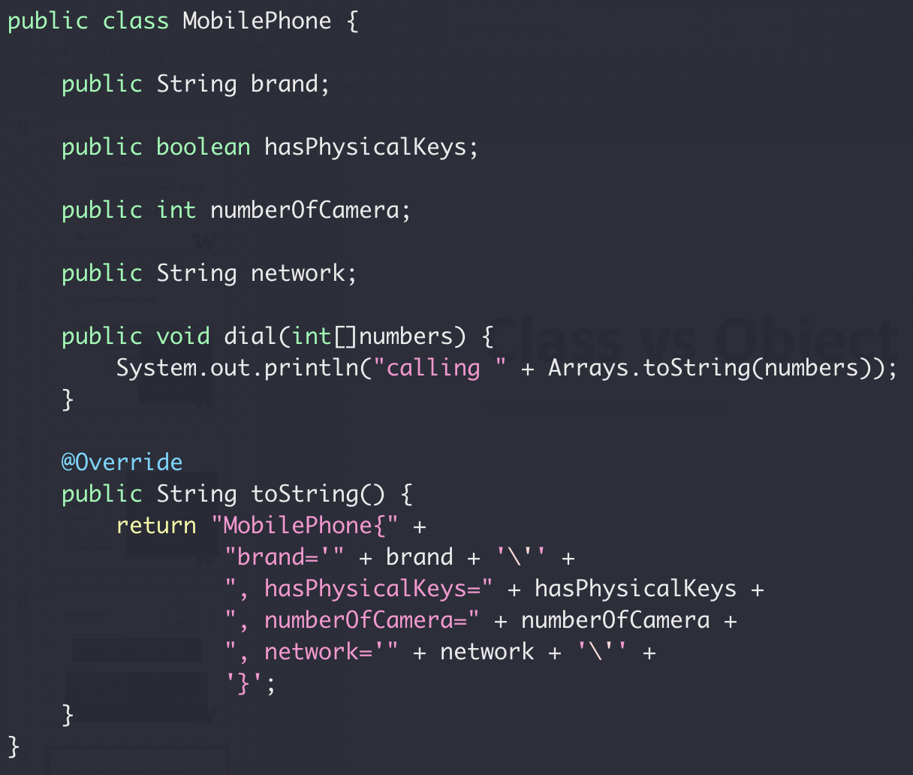
Class vs Object vs Instance vs Reference
A mobile phone, cell phone, cellphone, or hand phone, sometimes shortened to simply mobile, cell or just phone, is a portable telephone that can make and receive calls over a radio frequency link while the user is moving within a telephone service area. ---wikipedia
Mobile Phone
Class

Slide 21
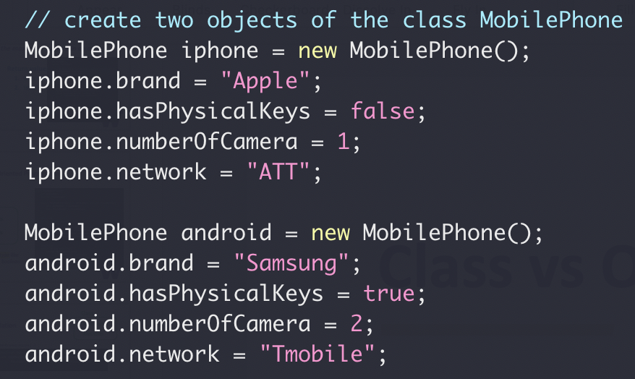
Class vs Object vs Instance vs Reference
iphone reference
0
2
1
2
iphone object
3
4
5
android reference
6
9
7
8
9
android object
10
11
Object/Instance

Slide 22
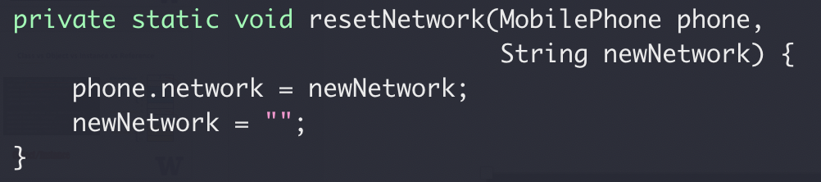
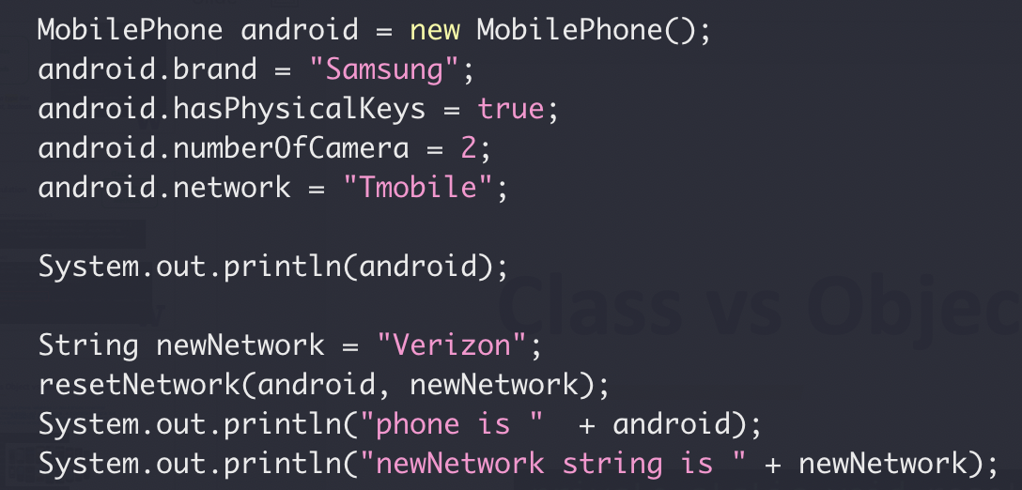
Class vs Object vs Instance vs Reference
0
2
1
2
3
4
5
6
9
7
8
9
10
11
What’s the output?

Slide 23
Class vs Object vs Instance vs Reference
Java always pass by value
Full code here

Slide 24
Class Exercise
Implement a class for cats
Member Variables:
Name
Gender
Age
Member Methods:
Speak
Play

Slide 25
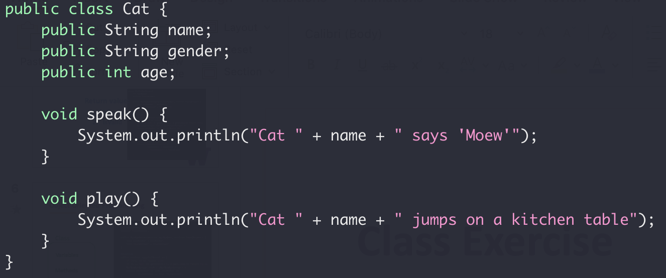
Class Exercise
Implement a class for cats

Slide 26
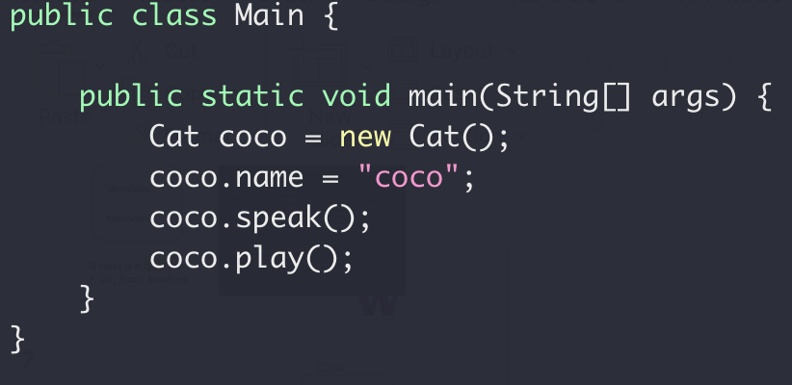
Class Exercise
Implement a class for cats

Slide 27
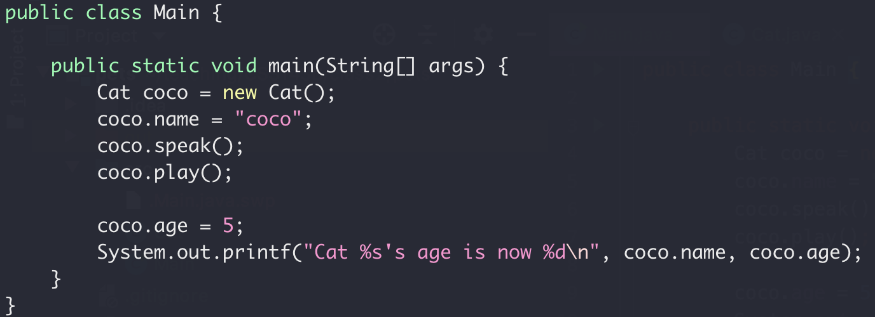
Encapsulation
Nop!
Your age is 5.
Me
☹

Slide 28
Encapsulation
Class
Variables
Variables
Setter/Getter
public Methods
Access
Methods
Read/Write
private Methods

Slide 29
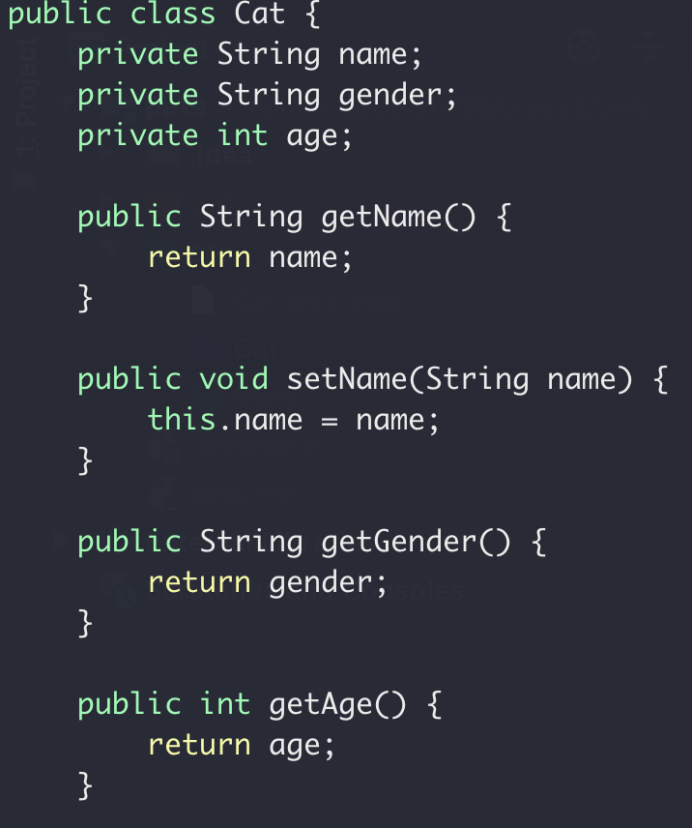
Class Exercise
Setter and Getter

Slide 30
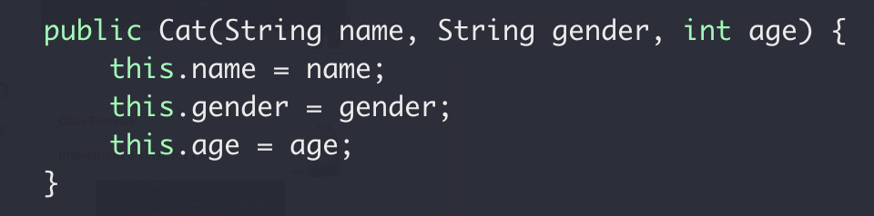
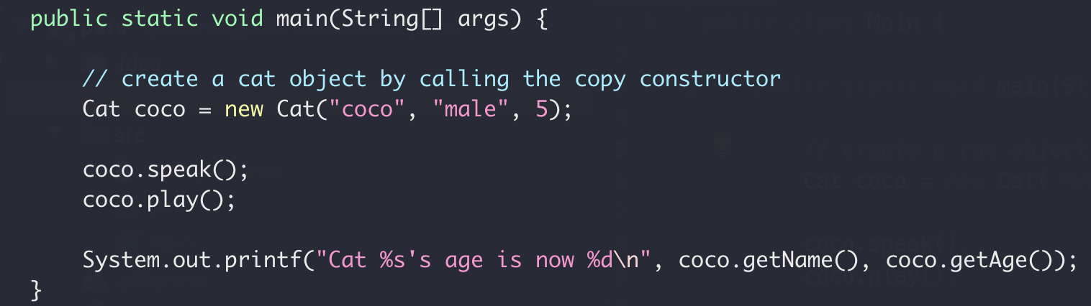
Class Exercise
Constructor

Slide 31
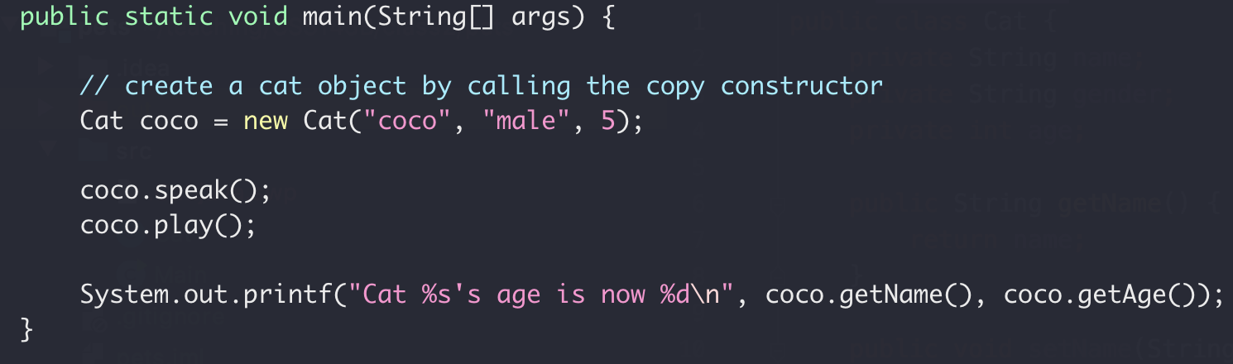
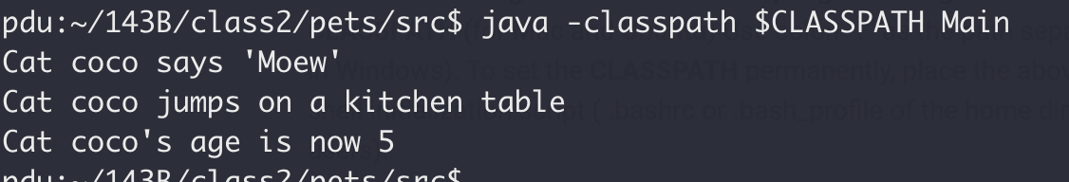
Class Exercise
Full code here version 0

Slide 32
Encapsulation Summary
Group properties (variables) and methods (that work on properties) into a single concept call “class”
Group properties (variables) and methods (that work on properties) into a single concept call “class”
Member variables should be private (not exposed to outside)
Member variables should be private (not exposed to outside)
What’s the default access level? Public or private?
Constructor to set/initialize members when creating object
Constructor to set/initialize members when creating object
Setter/getter for member properties access

Slide 33
Class Exercise
Implement a class for dogs
Member Variables:
Name
Gender
Age
Member Methods:
Speak
Play

Slide 34
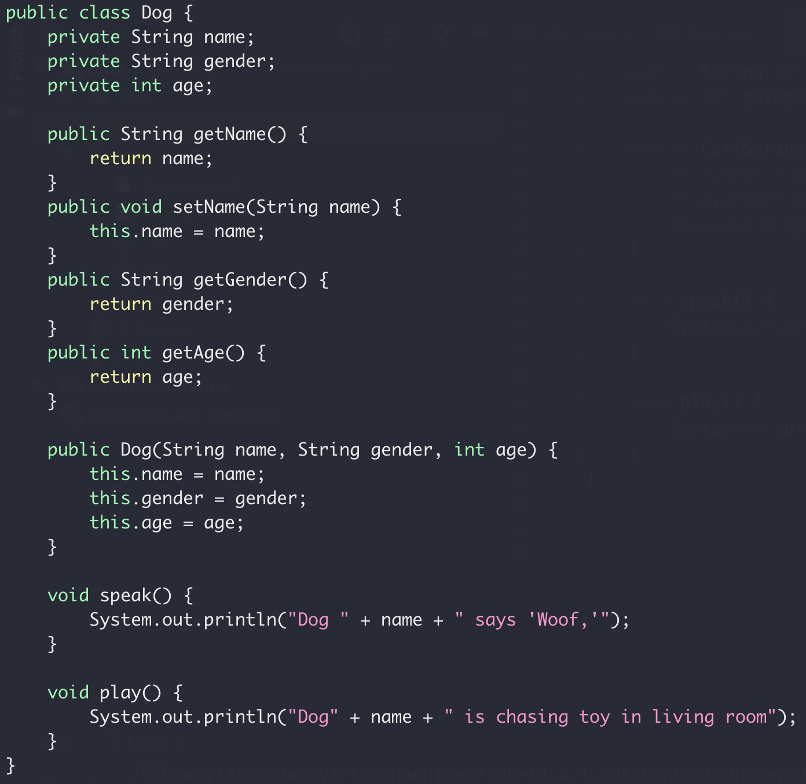
Class Exercise
Implement a class for dogs

Slide 35
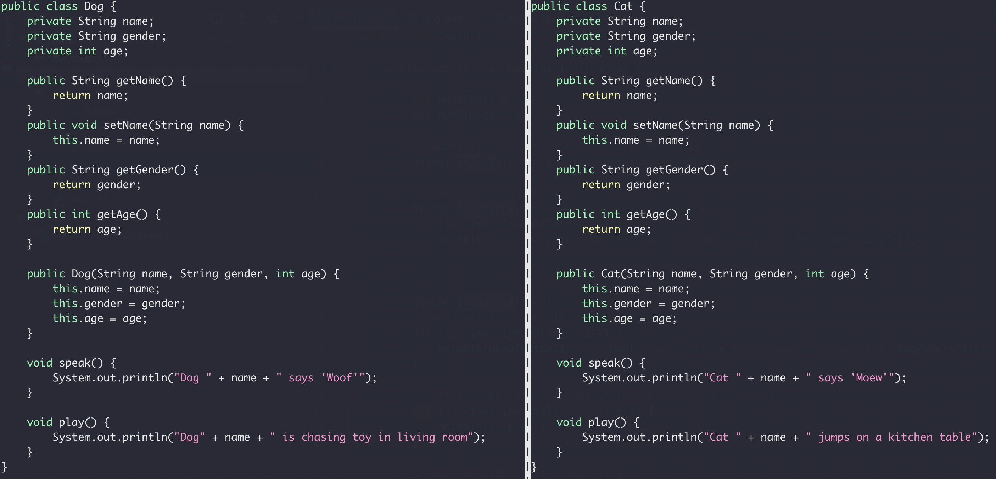
Inheritance
Compare the Cat and Dog class
Duplicated

Slide 36
Inheritance
Animal Class
Name
Gender
Age
Dog Class
Cat Class
Name
Gender
Age
Name
Gender
Age

Slide 37
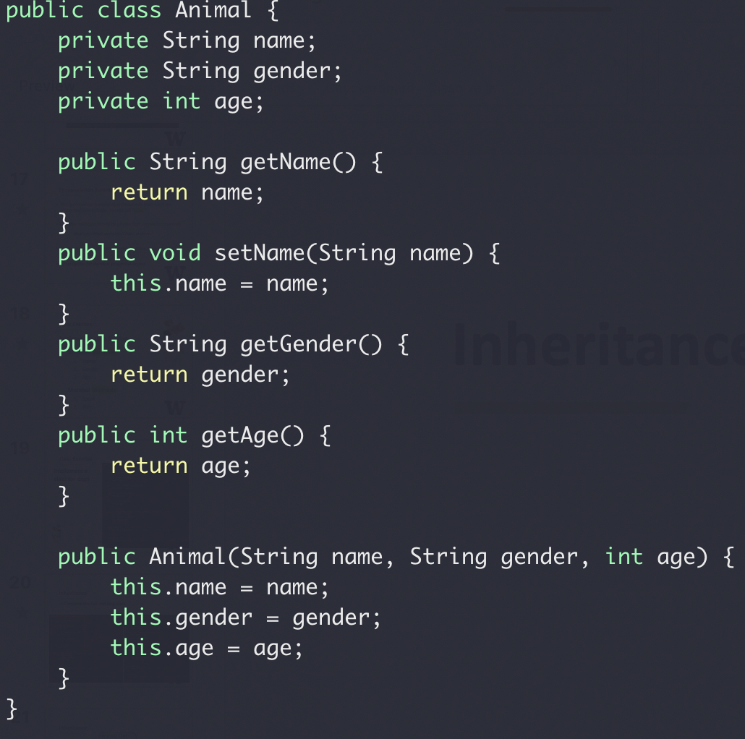
Inheritance
Animal Class
Name
Gender
Age
Base class constructor

Slide 38
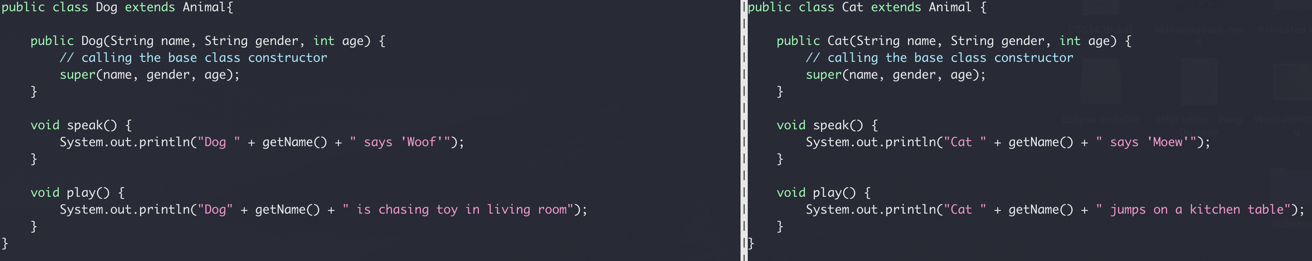
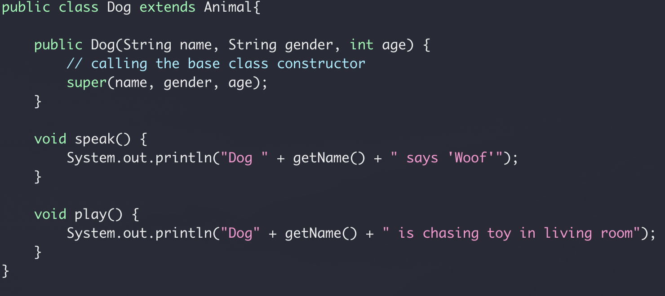
Inheritance
Compare the Cat and Dog class
inheritance
Calling based class constructor
Full code here version 1

Slide 39
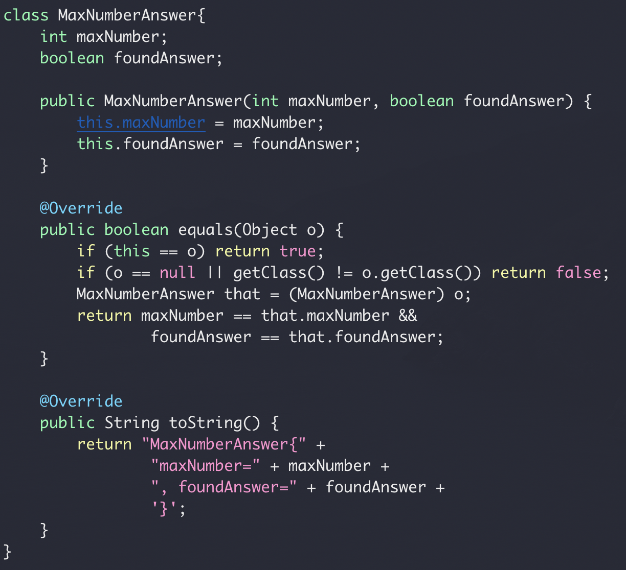
Inheritance
In Java, all classes are derived from the Object class
Yes, your own class too!
Override of the Object class equal() and toString()

Slide 40
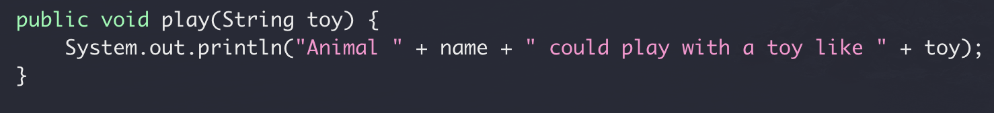
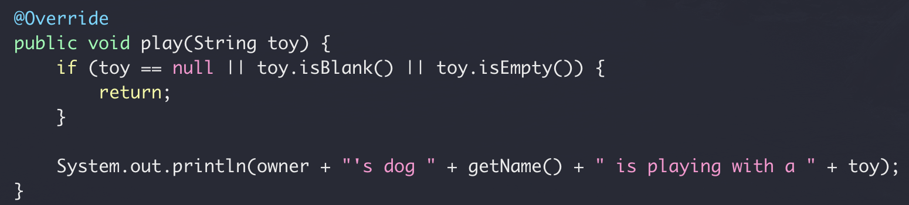
Override vs Overload
Override
Re-implement a function in derived class from base class with the
same name
same signature
Base class: Aniaml.Java
Derived class: Dog.Java

Slide 41
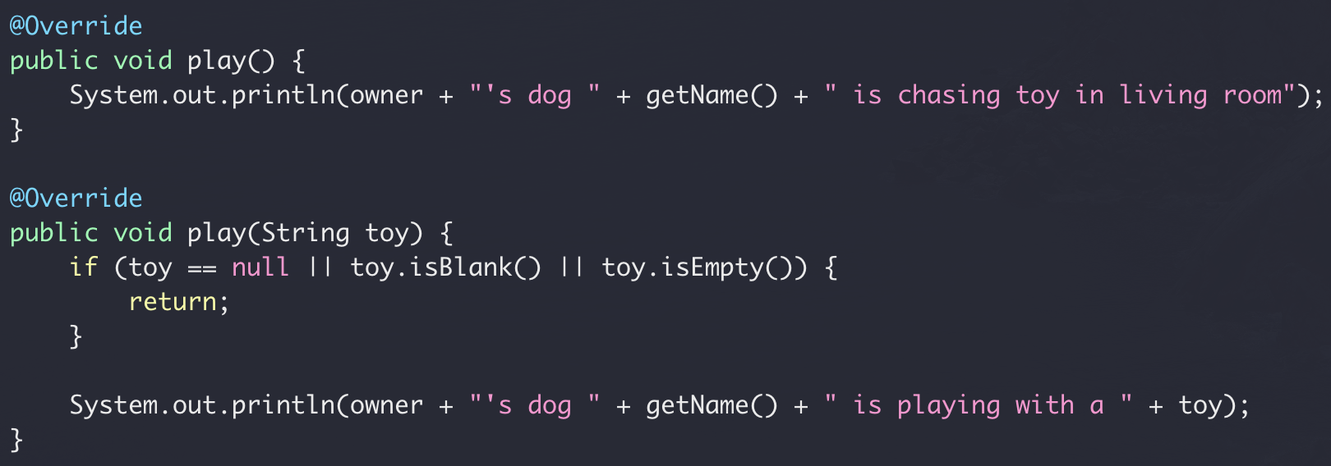
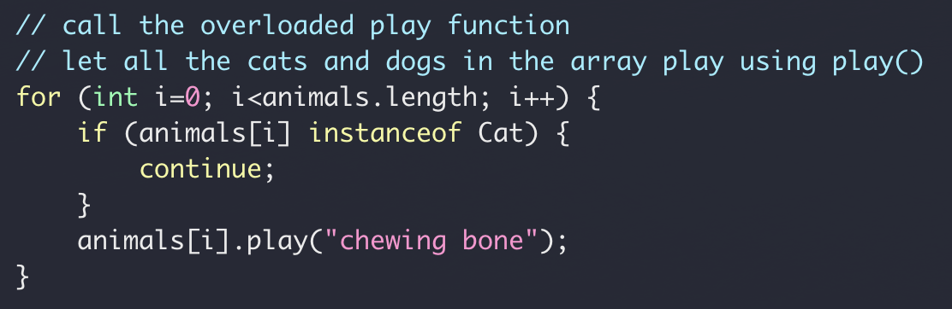
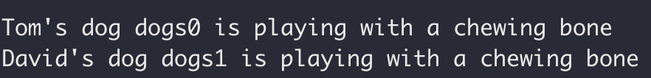
Override vs Overload
Overload
Re-implement a function in the same class
same name
different signature
Full code here
Derived class: Dog.Java

Slide 42
Inheritance Summary
Base class & derived class
Use super to access the base
Override vs Overload

Slide 43
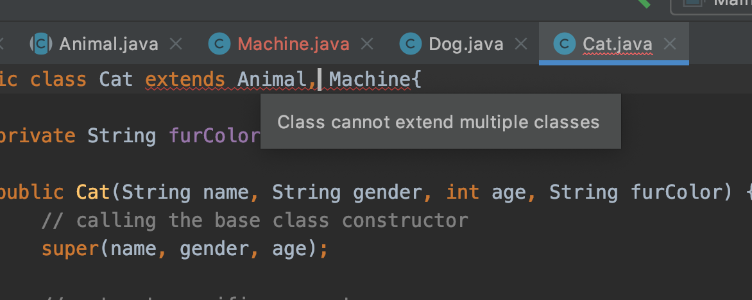
Inheritance Summary
Java does not support inheritance from multiple classes
Java does support inheritance from multiple interfaces
Class A
Class B
Class C
But why?

Slide 44
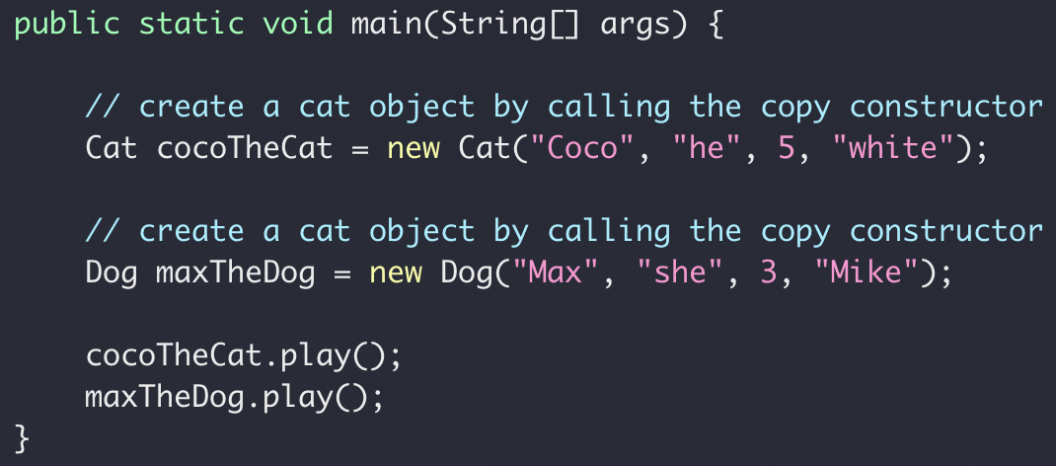
Class Exercise
Let all cats and dogs play
What if we have 300 cats and 200 dogs?
What if we have 3 cats and 2 dogs?

Slide 45
Polymorphism
Animal Class
public void play()
Dog Class
Cat Class
public void play()
public void play()

Slide 46
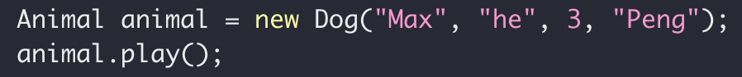
Polymorphism
Dog Instance
Assignment
Animal reference
public void play()

Slide 47
Polymorphism
Cat Class
Assignment
Animal reference
public void play()

Slide 48
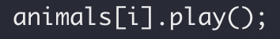
Polymorphism
Same reference type (base class), different objects (derived class)
“late binding”

Slide 49
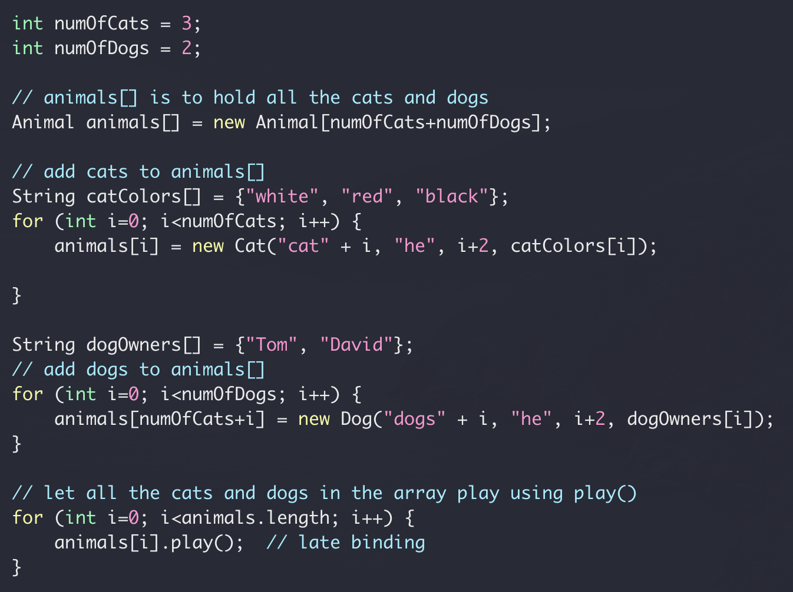
Polymorphism

Slide 50
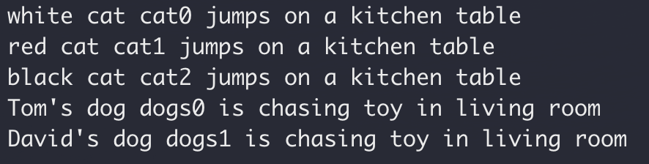
Polymorphism
Full code here (version 2)

Slide 51
Polymorphism Summary
Overridden method
Access using base class instance reference
Late binding: actual method being invoked is determined at run time
A more amusing example here

Slide 52
Abstract Class
Animal Class
public void play()
public void play()
No need to implement
Dog Class
Cat Class
Dog Class
Cat Class
public void play()
public void play()
public void play()
public void play()

Slide 53
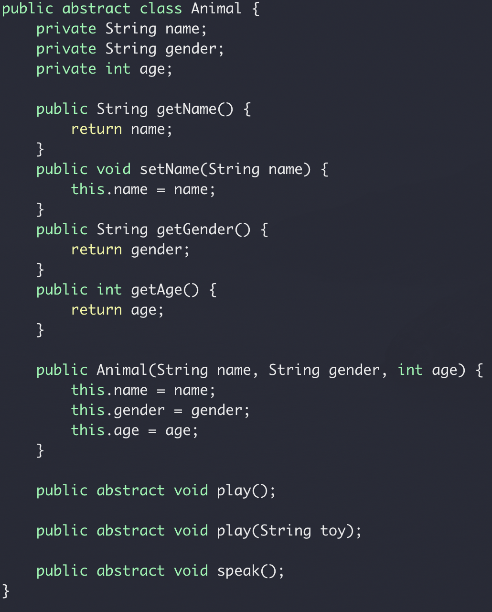
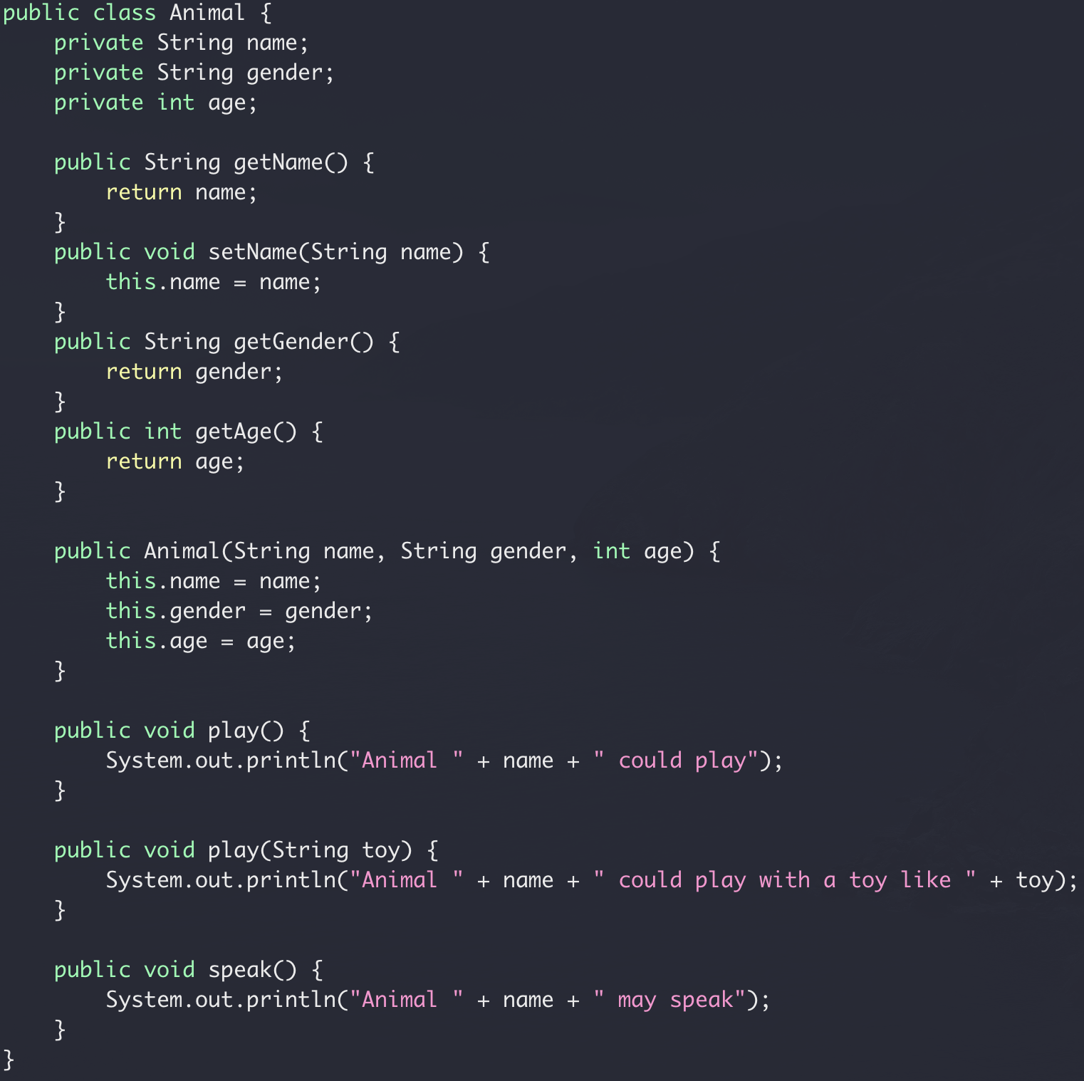
Abstract class
Full code here version 4

Slide 54
Java Class Review Summary
Encapsulation
Class vs Object/Instance vs Reference
Default access
Private member vs public method (setter/getter)
Inheritance
Base class and derived class
Calling base class copy constructor
Override vs Overload
Polymorphism
Accessing derived class object using base class reference

Slide 56
Abstract Data Structure
In class exercise
Design a class that represents a queue
First in, first out (“first come, first serve”)
Usage: queueing scheduling system, message queue
Img: https://www.123rf.com/photo_52465854_stock-vector-passengers-in-queue-waiting-check-in-counters-at-airport.html

Slide 57
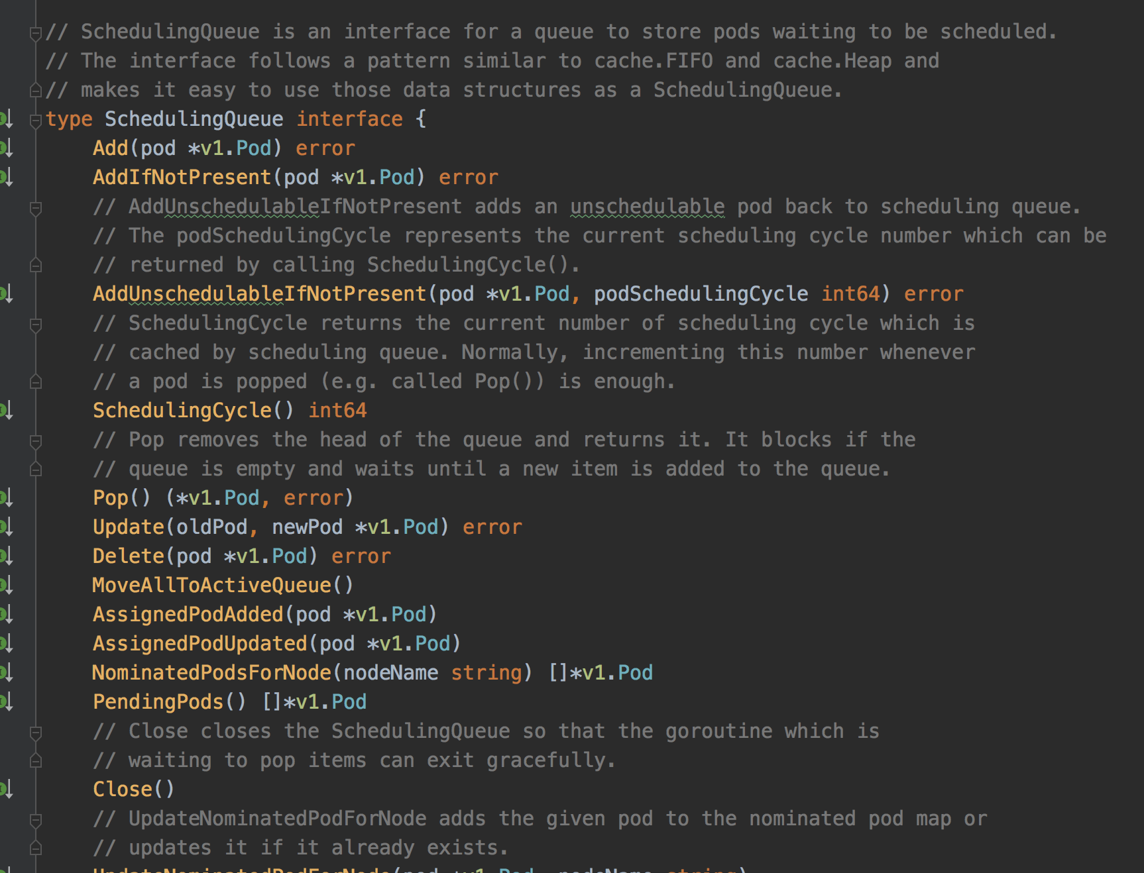
Queue example: Kubernetes Scheduler
pod
pod
pod
pod
pod
pod
pod
pod
Pod Queue
pod
pod
pod
pod
pod
pod
pod
pod
Scheduler
https://github.com/kubernetes/kubernetes

Slide 58
Queue Example: In the Linux Network Stack
Between the IP stack and the network interface controller (NIC) lies the driver queue.
The driver queue consists of descriptors which point to other data structures called socket kernel buffers (SKBs) which hold the packet data and are used throughout the kernel.
https://www.coverfire.com/articles/queueing-in-the-linux-network-stack/

Slide 59
Abstract Data Type (ADT)
Interface
Public functions
Implementation
- Internal details (not exposed to outside)

Slide 60
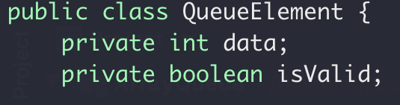
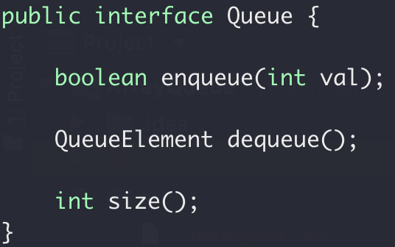
Abstract Data Type (ADT)
Interface
Public functions
Implementation
- Internal details (not exposed to outside)

Slide 61
Abstract Data Type (ADT)
Interface
Public functions
Implementation
- Internal details (not exposed to outside)
FIRST IN, FIRST OUT
What data structure to use?
Possibly many options.
Let’s go with array for now.

Slide 62
ADT Queue
Array Implement
enqueue
“front”
1
2
3
4
5
“end”
dequeue

Slide 63
ADT Queue
Array Implement
1
2
3
4
5
dequeue()
2
3
4
5
dequeue()
3
4
5
enqueue(6)
3
4
5
6
enqueue(7)
3
4
5
6
???

Slide 64
ADT Queue
Array Implement
1
2
3
4
5
dequeue()
2
3
4
5
dequeue()
3
4
5
enqueue(6)
3
4
5
6
enqueue(7)
7
3
4
5
6
enqueue(8)
7
8
3
4
5
6
Full!

Slide 65
ADT Queue
Array Implement
enqueue(6)
3
4
5
6
enqueue(7)
7
3
4
5
6
enqueue(8)
7
8
3
4
5
6
Full!
dequeue()
7
8
4
5
6
dequeue() x 4
8/8
dequeue()
empty

Slide 66
ADT Queue
Array Implement
end
https://hyperskill.org/learn/step/5355
2
3
4
5
front

Slide 67
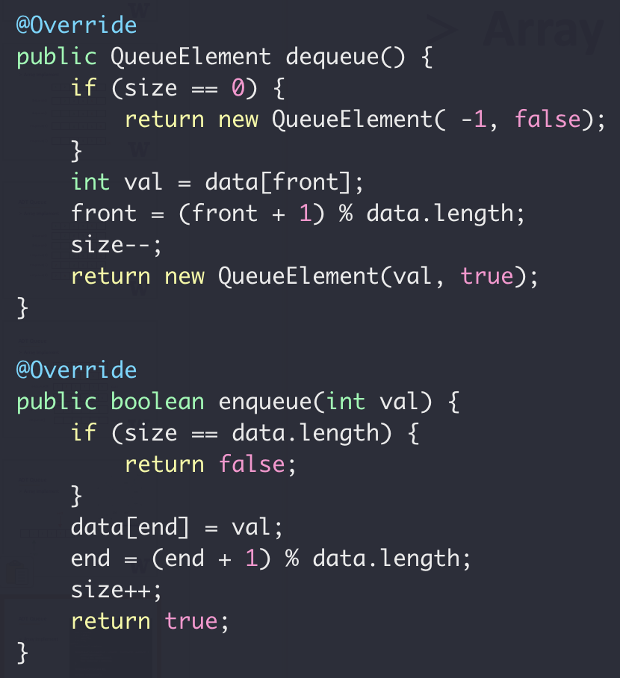
ADT Queue
Array Implement

Slide 68
ADT Queue
Array Implement
0 % 4 = 0
1 % 4 = 1
2 % 4 = 2
3 % 4 = 3
4 % 4 = 0
5 % 4 = 1
6 % 4 = 2
… …
C++ mod(%) operator

Slide 69
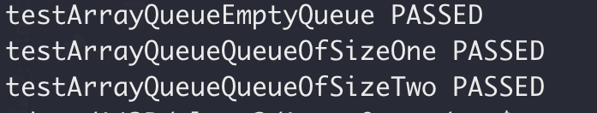
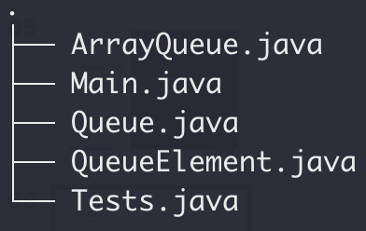
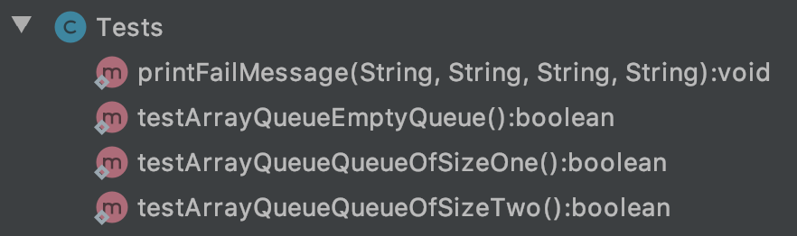
ADT Queue
Array queue test
Full code here

